Slide 1
NEO4J CYPHER TUTORIAL WITH PYTHON
Add Labels To Neo4j Node Using Apoc Procedure & Python
Tutorial 98

Slide 2
Use case
Add Labels To Neo4j Node Using Apoc Procedure & Python

Slide 3
Add Labels To Neo4j Node Using Apoc Procedure & Python
Code written in neo4j browser
match (a:Student)
with collect(a) as student
call apoc.create.addLabels(student,["BIO","PURE"])
yield node
return node

Slide 4
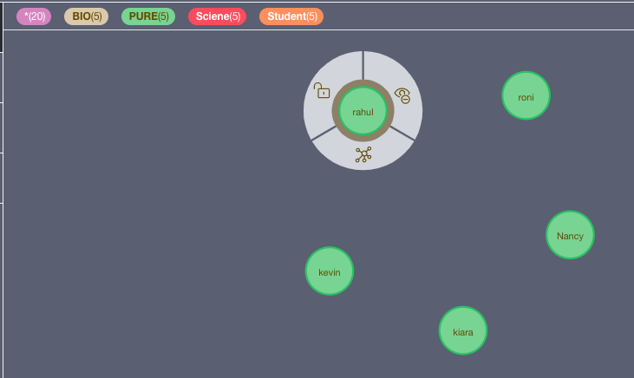
output
From python ide

Slide 5
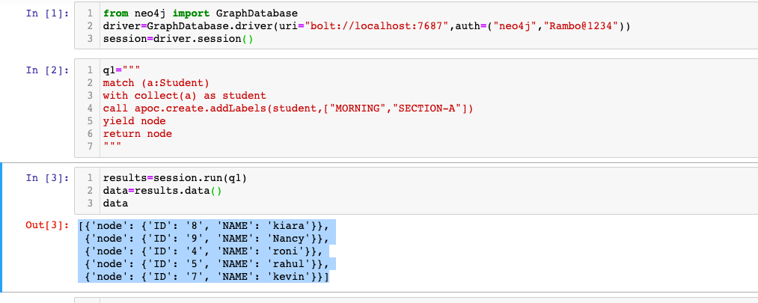
Add Labels To Neo4j Node Using Apoc Procedure & Python
Code written in python ide

Slide 6
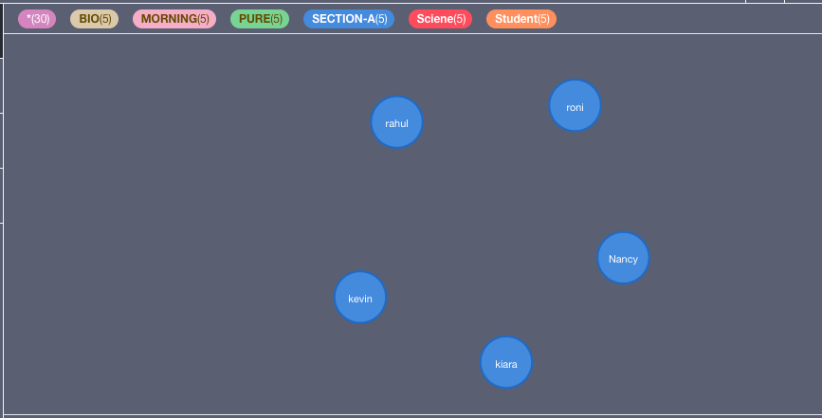
output
From python ide

